Slide 1

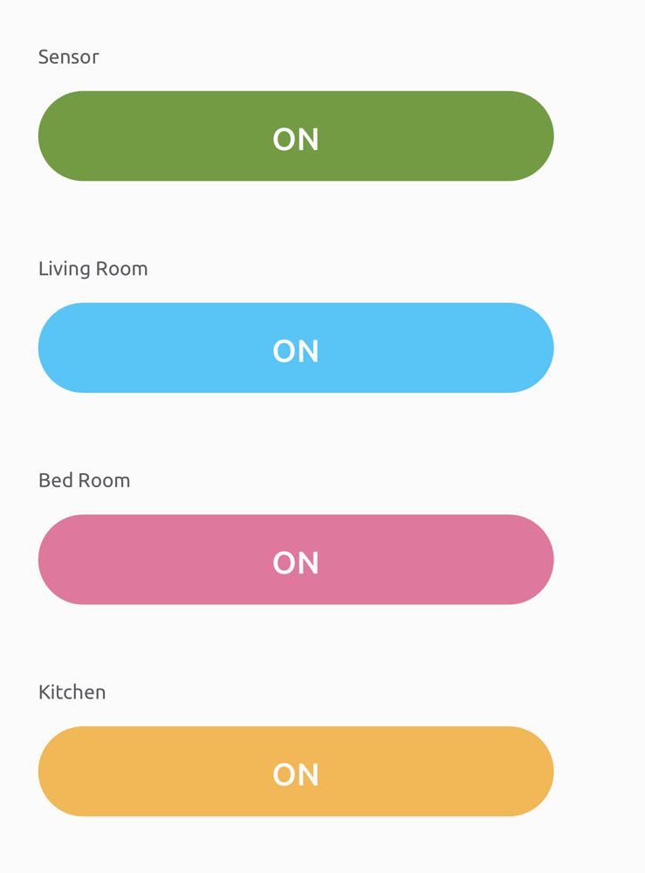
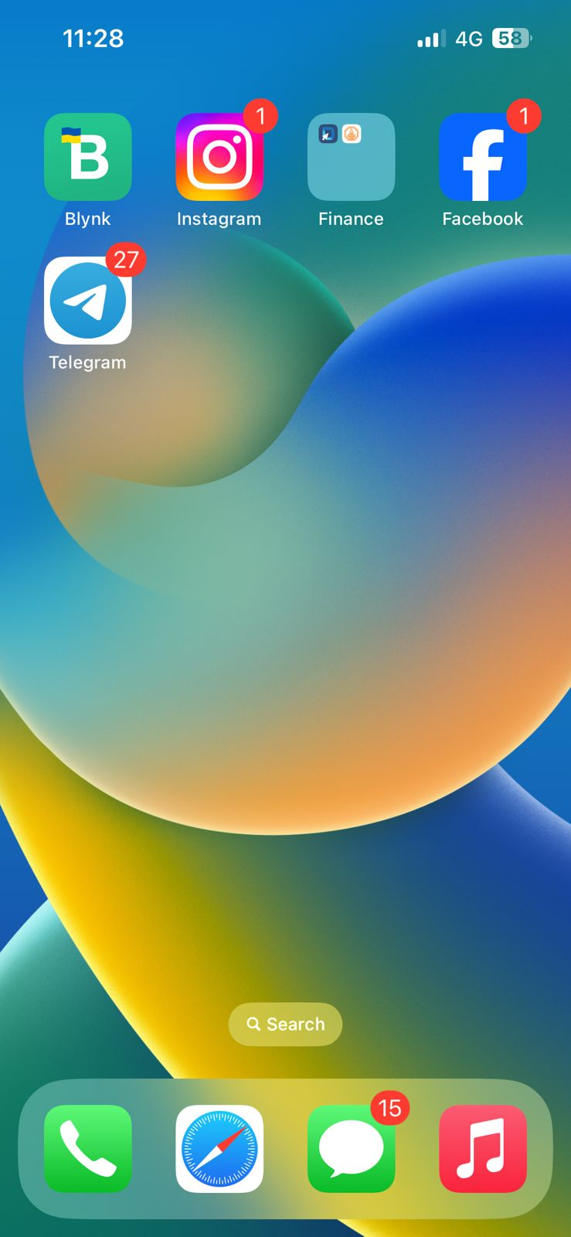
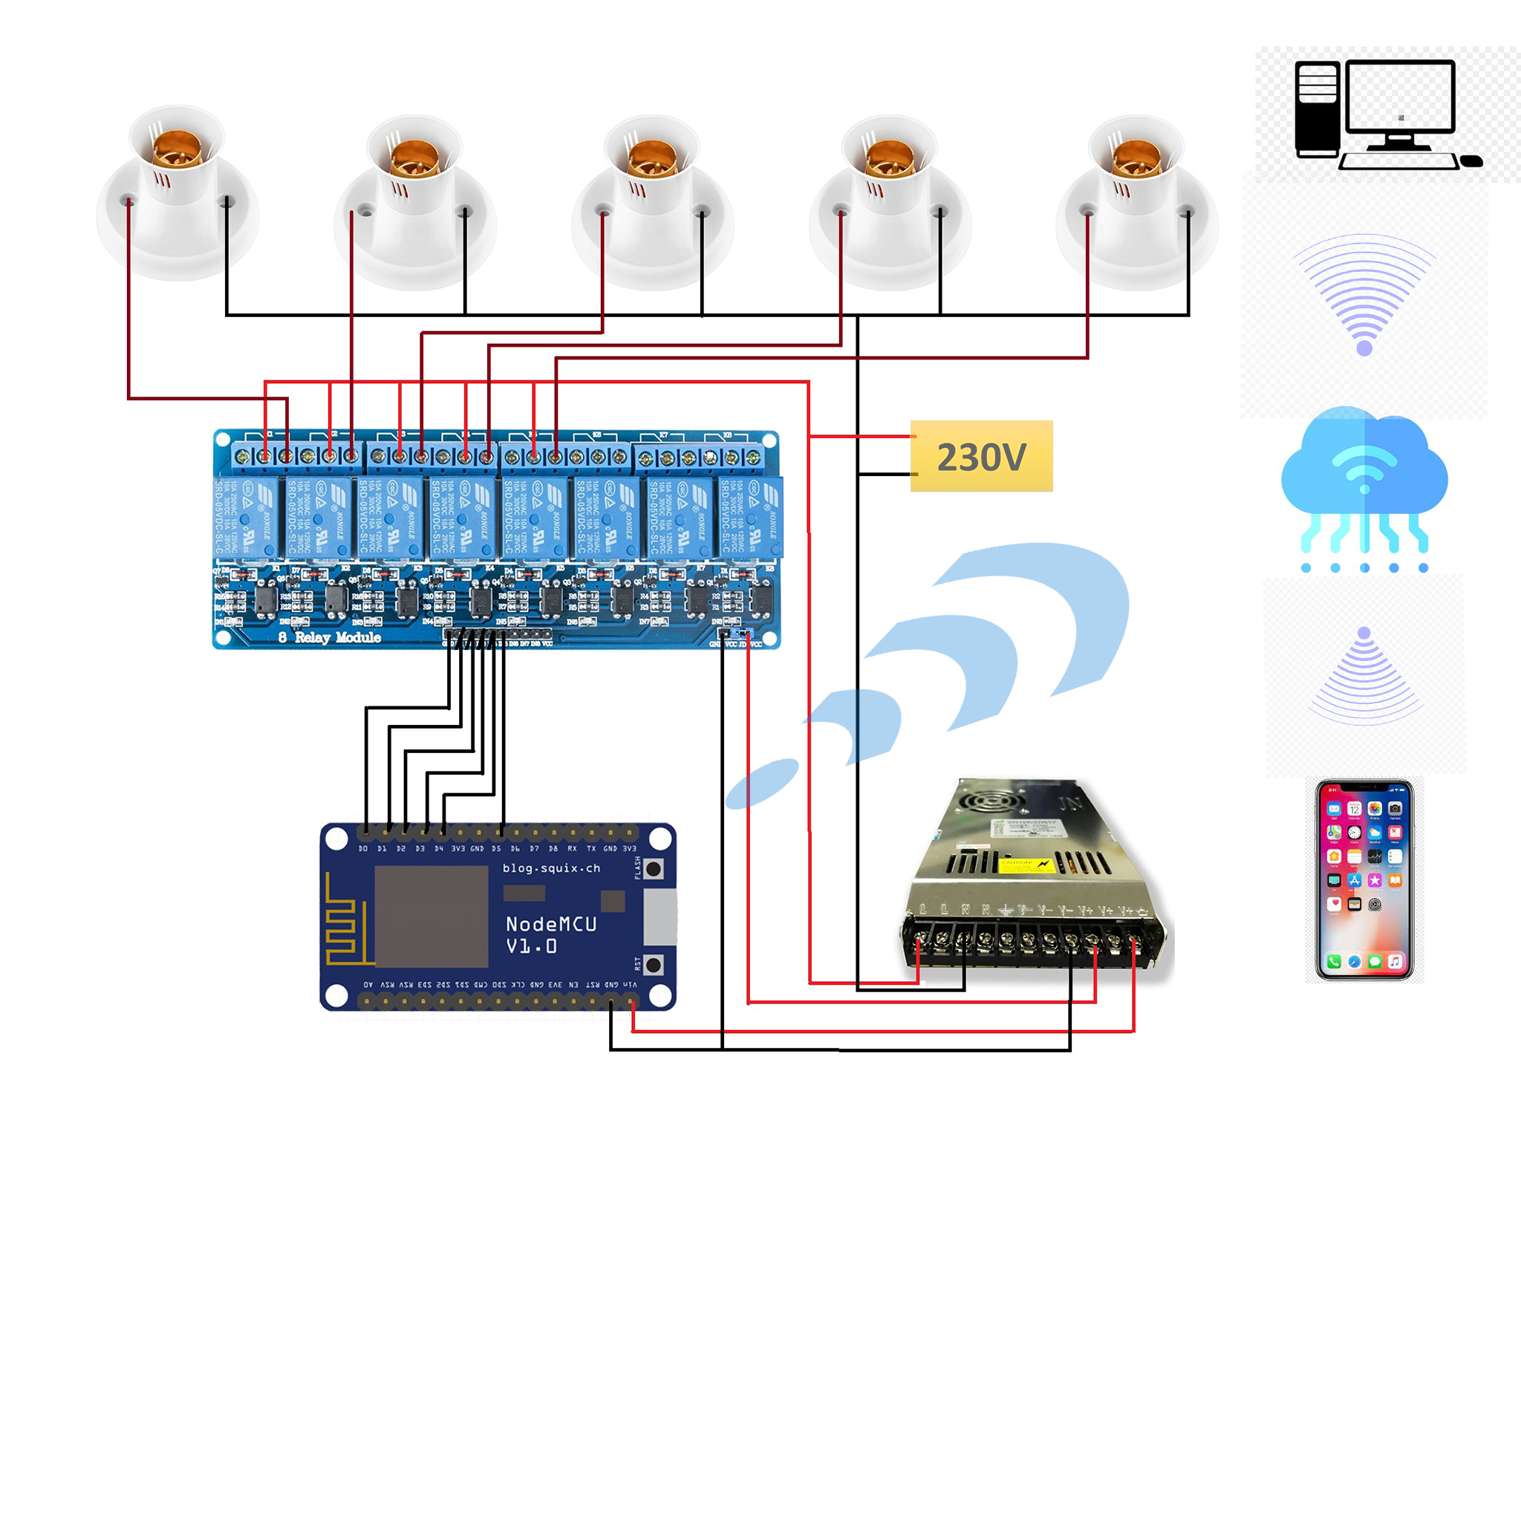
Home Automation System With Accumulate Current
ABSTRACT
Introduction
Results and discussion
This project demonstrates a real home automation system that allows the user to control it with a wireless device such as a WI-FI or mobile phone. A desktop PC is used to run the server software. The system allows the user to control each of the lights and sensors individually. It can automatically turn off the main lights and turn on a sensors at a specified time. By measuring the signal strength, it can detect when the user enters main door and automatically turn on the light to give signal, and then automatically turn them off when the user leaves the Main door.
Not only we place another sensor at gate to detect motion and open gate automatically by giving power to power line
Home automation is the automatic control of electronic devices in your home. These devices are connected to the Internet, which allows them to be controlled remotely. With home automation, devices can trigger one another so you don’t have to control them manually via an app
Result -
The benefits of home automation include safety, convenience, control, comfort, and energy saving. Because we can turn off unwanted power line through the internet. When the residence are not at in home.
Discussion -
When we are doing this project, we have decided to use some sensors to get more efficiency, so we have decided to use AC current for doing the control as a real house.
When normal automation system ,they use bulbs to control remotely through the cloud .In our system we use some sensors to adapt environmental conditions
and give signals to control unit to light up the automation system bulbs and power lines
In this project all sensors and bulbs working on 230V
Power with relay module
We use Blynk app to monitor and control the All-Power lines remotely through the Internet
System Overview
Conclusion
Main purpose of home automation system is to provide ease to people to control different home appliances with the help of the android/ ios application present in their cell phones and to save electricity, time and money. According to environmental Conditions.
Holders
Bulb
Node MCU
Eight channel Relay
Cell Phone
Blynk Code/App
AC/DC Wires
Wi-Fi
References
https://youtu.be/JgaKrPK4H-M?si=7XVw9NozMA8IPszn

